Slide 1

Fabric Admin 101
Settings, Tools, and Monitoring that Keep the Lights On and the Bills Down
Kristyna Ferris
Fun Fact: this font is dyslexic friendly! Ask me how to use it for free after the session.
Notes:
Top 10 Dyslexia-Friendly Fonts for 2026 | TypeSmith | TypeSmith
Download the font from Atkinson Hyperlegible - Google Fonts
Extract the files
Go to computer settings > personalization > fonts and drop in the files
Navigate to Power Point Master Slide
Change the font to use Open Dyslexic for the headers and body
Done!
Atkinson Hyperlegible uses exaggerated asymmetry between mirrored letter pairs (b/d, p/q) and uniquely shaped terminals that prevent letter confusion.
Its design by the Braille Institute incorporates research on visual processing differences to minimize misrecognition at any size.

Slide 2

About Me ~ Kristyna Ferris
Microsoft MVP, Data Platform & Fabric
Solution Architect, P3 Adaptive
Lexington Data Tech Group co-organizer
DataOnWheels Author
Blog
https://dataonwheels.wordpress.com/
LinkedIn
https://www.linkedin.com/in/kristyna-ferris-dataonwheels/
Twitter & Bluesky
@data_dragoness

Slide 3
Agenda
Key Fabric Concepts
Personas & Skills
Capacity Admin
Fabric Pricing
Live Walkthrough of Pulling Data into Fabric!

Slide 4
Key Fabric Concepts

Slide 5
Microsoft Fabric at a Glance
One platform for your entire data estate: from ingestion to insights.
Unified SaaS
OneLake
Built for Teams
Data Factory, Synapse, Power BI all under one roof with shared governance and a single billing model.
One data lake for the whole org.
No more data silos, no more copying data between services.
Data engineers, analysts, scientists, and admins all work in the same environment with role-based access.
If you're already on the Microsoft stack, Fabric isn't a new thing to learn. It's a better way to use what you know.
Notes:
Key point: Fabric is not a brand-new product from scratch. It's the unification of services most attendees already use (Power BI, Data Factory, Synapse). OneLake is the big differentiator: single storage layer.

Slide 6
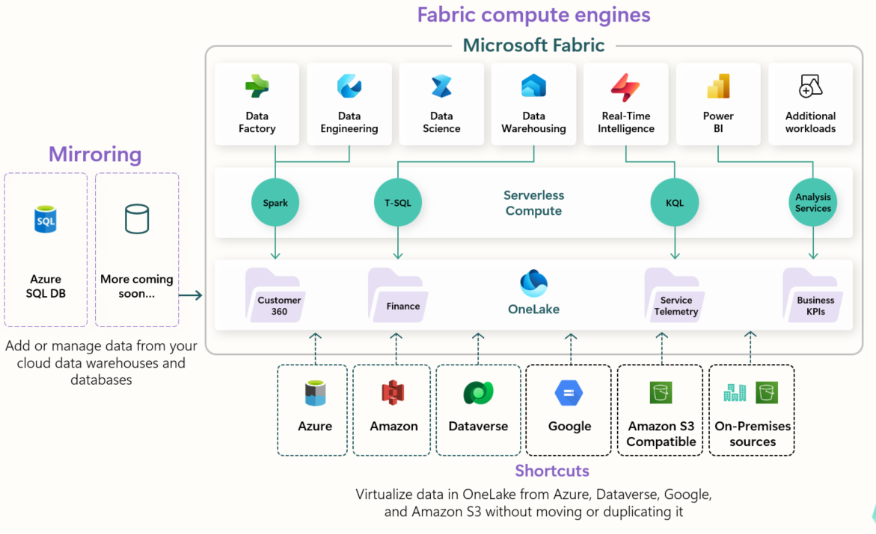
Microsoft Fabric at a Glance
Notes:
Key point: Fabric is not a brand-new product from scratch. It's the unification of services most attendees already use (Power BI, Data Factory, Synapse). OneLake is the big differentiator: single storage layer.

Slide 7
Microsoft Fabric Key Concepts 1
Tenant
Microsoft Fabric is deployed to a Microsoft Entra tenant. Each tenant is tied to a specific Domain Name System (DNS) and other domains can be added to the tenant.
Capacity
Resides within a Fabric tenant. Each capacity that sits under a tenant is a distinct pool of resources allocated to Fabric. Size of the capacity determines the amount of computation power available. You can have multiple capacities per tenant. Each tenant has a default shared capacity that does not cost anything, but it cannot run Fabric items and items are not sharable.
Shared capacity runs on a server shared with other tenants.
Dedicated capacity runs on a server that only contains your tenant’s data (FSKUs).
Workspaces
Resides within capacities. Used as containers for Microsoft Fabric items. Each user has a personal workspace called “My Workspace”. More workspaces can be created to enable collaboration. You can have multiple workspaces in a capacity.
Notes:
Microsoft Fabric concepts - Microsoft Fabric | Microsoft Learn
Your Ultimate Guide to Microsoft Fabric Pricing and Licensing
Power BI Premium Per User - Power BI | Microsoft Learn
What Is a Microsoft Tenant? Tenant Core Concepts Explained

Slide 8
Microsoft Fabric Key Concepts 2
Stock Keeping Units (SKU)
Provides a set of Fabric resources for your organization.
Individual User Licensing
Licenses that are applied to individuals such as Power BI Pro and Power BI Premium Per User. These two licenses are purchased through Microsoft 365 portal.
Pay-As-You-Go Pricing
Fabric SKUs (FSKUs) that are purchased as needed. Can be set up to automatically scale up and down based on need and can be easily paused to save money when not in use. Ideal for work loads that do not need to run all the time and have highly variable consumption.
Reserved Pricing
FSKUs that are purchased at least a year in advance for a 40% pricing discount. Ideal for work loads that require continuous up time.
Notes:
Microsoft Fabric concepts - Microsoft Fabric | Microsoft Learn
Your Ultimate Guide to Microsoft Fabric Pricing and Licensing
Power BI Premium Per User - Power BI | Microsoft Learn

Slide 9
Personas & Skills

Slide 10



Fabric Personas
Data Engineers
PBI Developers
Report Viewers
Create Fabric artifacts
Build & Orchestrate
(lakehouses, warehouses, notebooks, data pipelines, etc.)
Create Power BI semantic models & reports
Model & Report
** Publish reports to shared workspaces
View & Analyze
*** Utilize Power BI reports to answer business questions
** Requires either a pro or ppu license
*** Requires a pro license if in a shared workspace, ppu license if in a ppu workspace, and no license if in a F64 capacity workspace
Notes:
Microsoft Fabric concepts - Microsoft Fabric | Microsoft Learn
Pro workspaces allow for 10 GB size datasets, only 8 refreshes a day.
PPU workspaces allow for 100 GB size datasets, 48 refreshes a day, advanced dataflow features, deployment pipelines, xmla connectivity, page refresh, incremental refresh.

Slide 11
Data Engineer Skills
You Probably Have
Worth Picking Up
✓
SQL & T-SQL fundamentals
→
PySpark / Spark SQL basics
✓
ETL / ELT pipeline thinking
→
Delta Lake (versioning, time travel, merge)
✓
Data Factory or SSIS experience
→
Lakehouse architecture patterns
✓
Understanding of data warehousing concepts
→
Notebook development workflows
→
OneLake shortcuts & mirroring
Notes:
Most data engineers on the MS stack already have the left column covered. The right column is the growth area — PySpark and Delta Lake are the biggest learning curves.

Slide 12
Analyst & BI Developer Skills
You Probably Have
Worth Picking Up
✓
Power BI report building & DAX
→
DirectLake mode (how it differs from Import/DQ)
✓
Semantic model design (star schema)
→
Workspace and deployment pipelines
✓
Power Query / M
→
SQL analytics endpoint for ad-hoc queries
✓
Data visualization best practices
→
Fabric-native dataflows (Gen2)
→
OneLake integration with existing reports
Notes:
BI devs — this is the biggest audience segment. DirectLake is the headline feature for them. Mention that their Power BI skills transfer directly.

Slide 13
Admin Skills
Fabric
Admin
✓
M365 / Azure AD admin experience, Power BI admin
→
Capacity Units (CU) model & SKU sizing
→
Tenant settings specific to Fabric (171+ settings!)
→
Monitoring tools like Capacity Metrics App, FUAM,
Notes:
Faster pass on these two since they're smaller audience segments. The admin mention here tees up the capacity section. '171+ tenant settings' is a good hook — gets a reaction.

Slide 14
Capacity Administration

Slide 15
Critical Security Settings
Publish to web – disable! Trust me, you don’t need this
Guest users can access Microsoft Fabric – disable or restrict
Users can invite guest users to collaborate through item sharing and permissions – disable or restrict
External data sharing – disable
Allow shareable links to grant access to everyone in the org – disable
Users can send email subscriptions to external users - disable
Notes:
Tenant Setting Index: Tenant settings index - Microsoft Fabric | Microsoft Learn
Easier to grab via the markdown file (click the three dots next to the title on the page then hit copy markdown)

Slide 16
Critical Governance Settings 1
Users can create Fabric Items – limit to security groups. This one saves you from worrying about a ton of little settings
Export to Excel – limit to security groups if possible
Service principals can call Fabric public APIS – limit to security groups
Notes:
Tenant Setting Index: Tenant settings index - Microsoft Fabric | Microsoft Learn
Easier to grab via the markdown file (click the three dots next to the title on the page then hit copy markdown)

Slide 17
Critical Governance Settings 2
Create workspaces – limit to security groups
Users can try Microsoft Fabric paid features. Turn this off unless you want people to spin up trial capacities.
Users can use copilot and other features powered by Azure OpenAI. Restrict this to specific groups until you know your capacity impact
Notes:
Tenant Setting Index: Tenant settings index - Microsoft Fabric | Microsoft Learn
Easier to grab via the markdown file (click the three dots next to the title on the page then hit copy markdown)

Slide 18
Capacity Settings
Set up notifications on capacity usage
Set up surge protection
Set up capacity overage
Set certain workspaces as mission critical

Slide 19

Demo time!
Admin portal orientation
Tenant settings
Capacity notification settings

Slide 20
Pricing

Slide 21
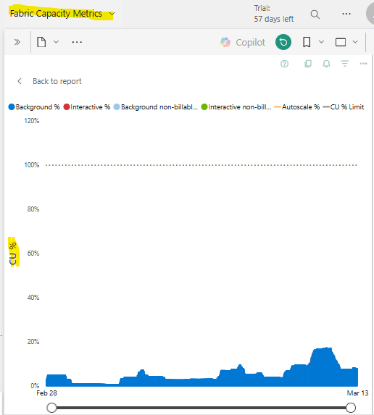
Picking out a Fabric SKU
Use a Fabric Trial!
60 days of free F64 usage
Aim for maximum 80% of capacity
Multiple developers? Min rec SKU is F8
Multiple data sources to ingest? Min rec SKU is F16
A lot of report viewers? Consider a F64 for free viewer licensing (discussed more in upcoming slides)
Environment concerns? Use diff capacities for dev, test, prod
Notes:
Install the Microsoft Fabric capacity metrics app - Microsoft Fabric | Microsoft Learn
F8 allows for multiple spark sessions at a time for notebooks. This allows more than one developer to be working in a notebook at once.
F16 has proven to be a good SKU for ingesting multiple data sources into Fabric using a metadata driven approach.
F64 unlocks more capabilities, but those are not unlocked with a F64 reservation, only with a F64 capacity.

Slide 22
How Do Reservations Work?
Reservation Scenario 1
F64 split
Annual contract with Microsoft for a 41% discount on F SKUs.
Can be paid monthly or upfront.
These SKUs can be split into multiple capacities or all used within one capacity.
You pay for all the SKUs even if they are not assigned to a capacity, so it is best to use them all.
You can get cancel, exchange, or refund reservations with certain limitations
Capacity 1 | F16
Capacity 3 | F32
Capacity 2 | F16
Reservation Scenario 2
F64 one capacity
Capacity 1 | F64*
* These workspaces get the benefits of an F64 capacity (Copilot, free license viewing, and AI skills)
Notes:
https://learn.microsoft.com/en-us/azure/cost-management-billing/reservations/fabric-capacity#cancel-exchange-or-refund-reservations

Slide 23
Breakeven Points
Reserved versus pay-as-you-go
F64 Compared to Power BI
730 hours FSKU reserved
(a month)
=
434 hours FSKU pay-as-you-go
(18 days)
F64
=
358 pro licenses
=
209 ppu licenses
Notes:
Microsoft Fabric - Pricing | Microsoft Azure
Breakeven points:
F64 = 358 pro licenses = 209 ppu licenses
730 hours FSKU reserved (a month) = 434 hours FSKU pay-as-you-go (18 days)
If you only need capacity for <14 hours a day, pay-as you-go is the best option

Slide 24
Fabric Walkthrough

Slide 25

Demo Time!

Slide 26

Don’t forget to connect, thanks for listening!
https://dataonwheels.wordpress.com/
kristyna@dataonwheels.com
@data_dragoness
GitHub

